Slide 1
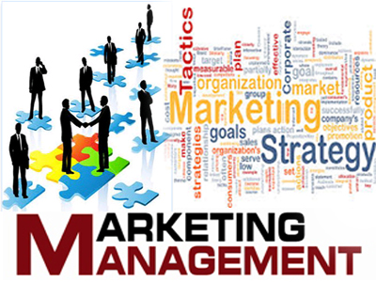

MARKETING MANAGEMENT ON NOODLES
NAME : T. Sai Koushik(192125035)
&
P.LATHEESH(192111222)
COURSE : principle of management
COURSE CODE : UBA3366
COURSE: PRINCIPLES OF MANAGEMENT
COURSE CODE: UBA3366

Slide 2

ABSTRACT:
This project involves Market Research for a Company launching new variety of Noodles.
In Market which will be competing against highly popular and existing brands of noodles.

Slide 3
In this market research, we have to prepare a questionnaire and the research is primarily focused on local shops (Kirana shops).
The four P’s (Price, Place, Promotion, and Product) in marketing has definitely helped the noodles establish itself as a top-notch brand .

Slide 4

OBJECTIVES:
Creation of Demand: The marketing management's first objective is to create demand through various means.
Customer Satisfaction
Market Share
Generation of Profits
Creation of Goodwill and Public Image

Slide 5
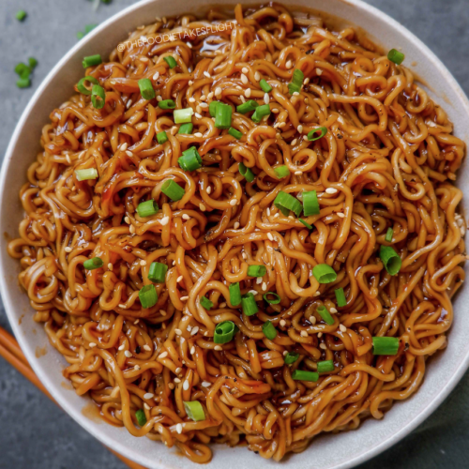
INTRODUCTION:
Marketing management is the process of planning and executing the conception, pricing, promotion, and distribution of ideas, goods, and services to create exchanges that satisfy individual and organizational goals.
noodles that originated in Switzerland in the late 19th century.

Slide 6
Noodles was the first to bring protein-rich legume meals to the market, and followed up with a ready-made soup based on legume meals in 1886.
which was more famous and favorite for Indians, especially kids.
The company originated in Switzerland in 1884, when Julius Maggi took over his father's mill.

Slide 7
LITERATURE SURVEY: Gastronomy as a mean of marketing management and rural destination development
Aleksandra Vojtko, Mirjana Delis-Jović, Olgica Zečević-Stanojevic, Leposava Zečević, Dragan Nedeljkovic
Serbian Journal of Engineering Management 5 (1), 1-13, 2020 Culinary experience is an unforgettable experience and a highlight for many tourists.

Slide 8
A Study in Consumers preferences towards Various Brands of Instant Noodle
Marketing is most important part of the business. Marketing is very poor in a developing country like ours.
To increase the economic state of developing country, marketing plays major role.

Slide 9
Importance of Consumer Behavior–A Case Study of Maggi Noodle, Nestle India
In today’s world, consumers’ product and service preferences are constantly changing.
Marketing managers must understand these desires in order to create a proper marketing mix for a well-defined market.

Slide 10
Materials and Methods:
1.Prioritize a content strategery
If you want to promote your company or products, it’s essential to prioritize online content.
Having good content sets your website apart from your competitors and delivers the correct message to your customers.

Slide 11
2. Employ the right staff
You need to make sure that you employ the correct team for your marketing management strategies.
You can do this by making sure that you have staff that is comfortable with writing online content from your current workforce.

Slide 12

DISCUSSION:
Noodles Manufacturing Detailed Project Report (DPR) is a complete package that contains everything that requires getting funds up to 25 Crores (Twenty-Five Crores).
Usually, the Detailed Project Report (DPR) is needed when you apply for a bank loan or Government scheme.

Slide 13
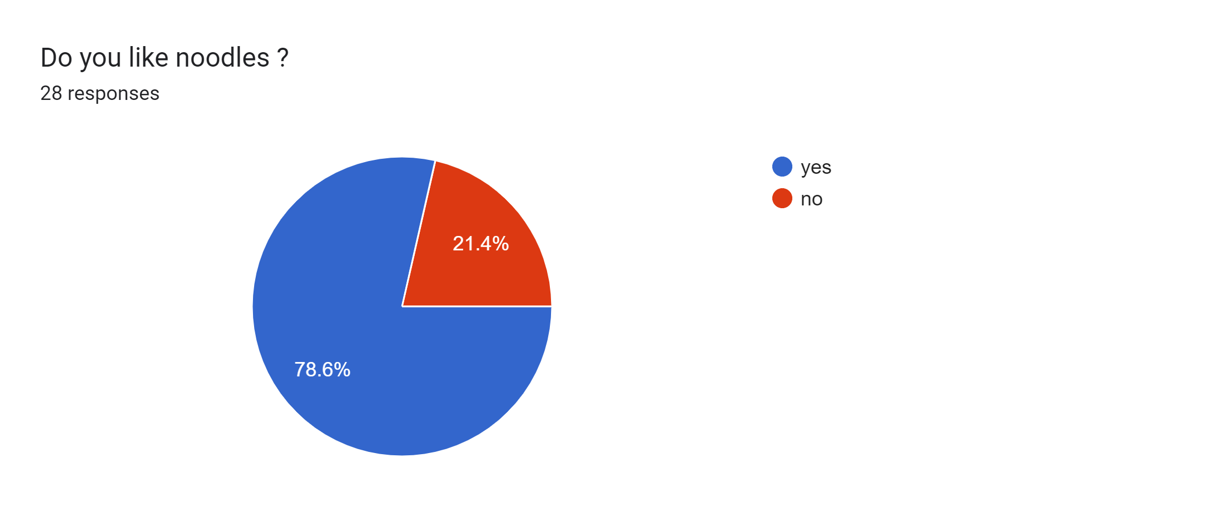
RESULTS: REVIEWS:

Slide 14
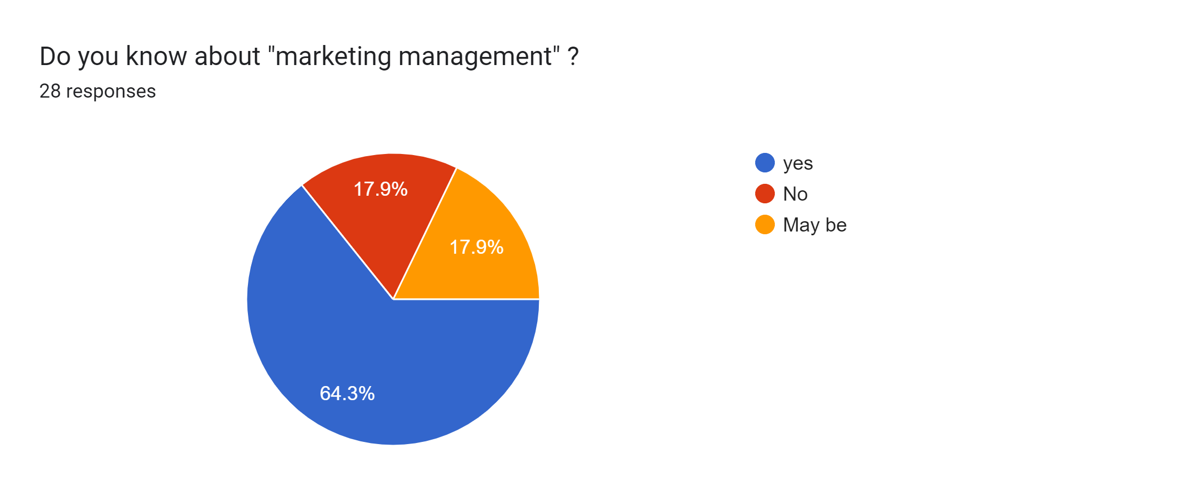

Slide 15
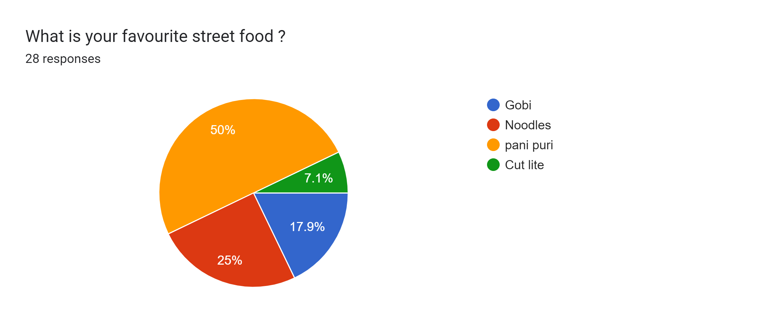
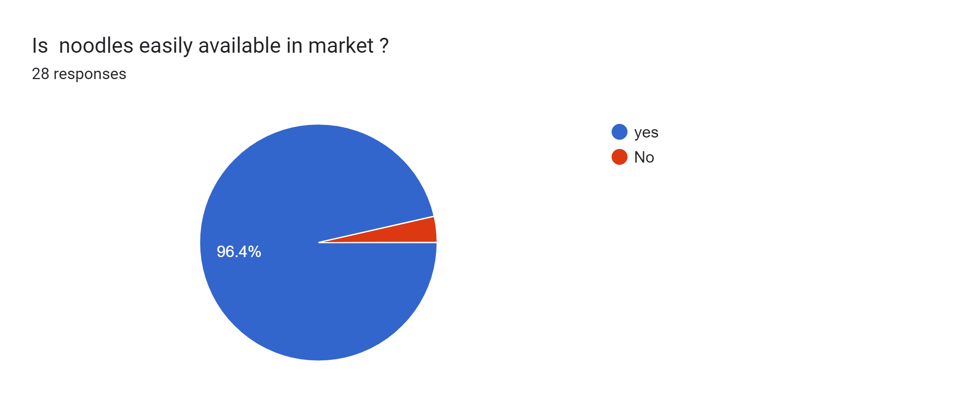

Slide 16
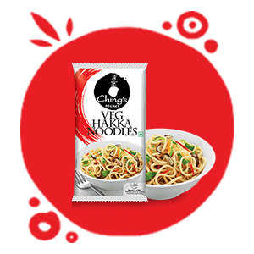
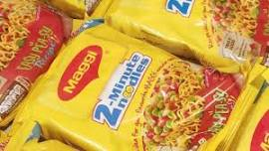
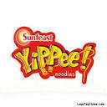
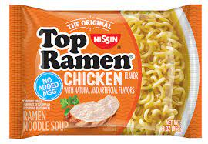
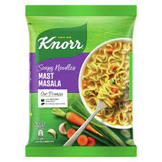
Most eaten Noodle Brands:
Maggi
Yippee!
Top Ramen
Ching's Secret
Knorr Soupy Noodles

Slide 17
ADVANTAGES: 1.Sustained Energy 2.Balanced Diet
DISADVANTAGES:
1.diabetes
2.high blood pressure
3.heart problems

Slide 18

PROBLEMS:
No Clear Strategy.
Smart Insights tells us about 50 percent of companies using digital marketing
Lack of Time and Resources.
No Alignment with Buyer Personas.
Inability to Adapt to New Trends.

Slide 19

PROBLEM STATEMENT:
Perform a search in order to define your personal.
List the activities of each funnel step.
Invest time in data analysis.
Bring marketing closer to the sales team.
Automate your actions.

Slide 20
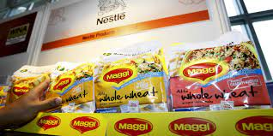
CONCLUSION:
Marketing management is an important area of business that generates revenue for sake of goods and service through the consumer
it is responsible for taking a decision in the area's product price place and promotion, keeping price, and place in view the requirement of business.

Slide 21
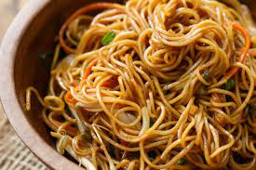
REFERENCES:
1.Dibb, S. (2010). Market Segmentation Success–Making it Happen! Strategic Direction,
2. Jaworski, B. J. (2018). Commentary: advancing marketing strategy in the marketing discipline and beyond. Journal of Marketing Management,
3. Keller, K. L., & Brex Endorf, T. O. (2017). Measuring brand equity. Hand Buch Marken führung.
4. Khan, M. T. (2014). The concept of 'marketing mix' and its elements (a conceptual review paper). International journal of information, business and management, 6(2), 95.
5. Kim, K. H., Jeon, B. J., Jung, H. S., Lu, W., & Jones, J. (2012). Effective employment brand equity through a sustainable competitive advantage, marketing strategy, and corporate image. Journal of Business Research.

Slide 22


